Slide 1

PID Pendulum
TRR
By: Joe S, Matt H, Austin C, and Kat S
1

Slide 2

Agenda - Kat
Current Build Status​
AI&T Flow​
AI&T Schedule​
Verification Matrix​
Requirements Validation Status​
Component-Level Verification​
Subsystem-Level Verification​
System-Level Verification​
Comprehensive Performance Test (CPT)​
Environmental Tests​
Problems and Potential Issues​
2

Slide 3
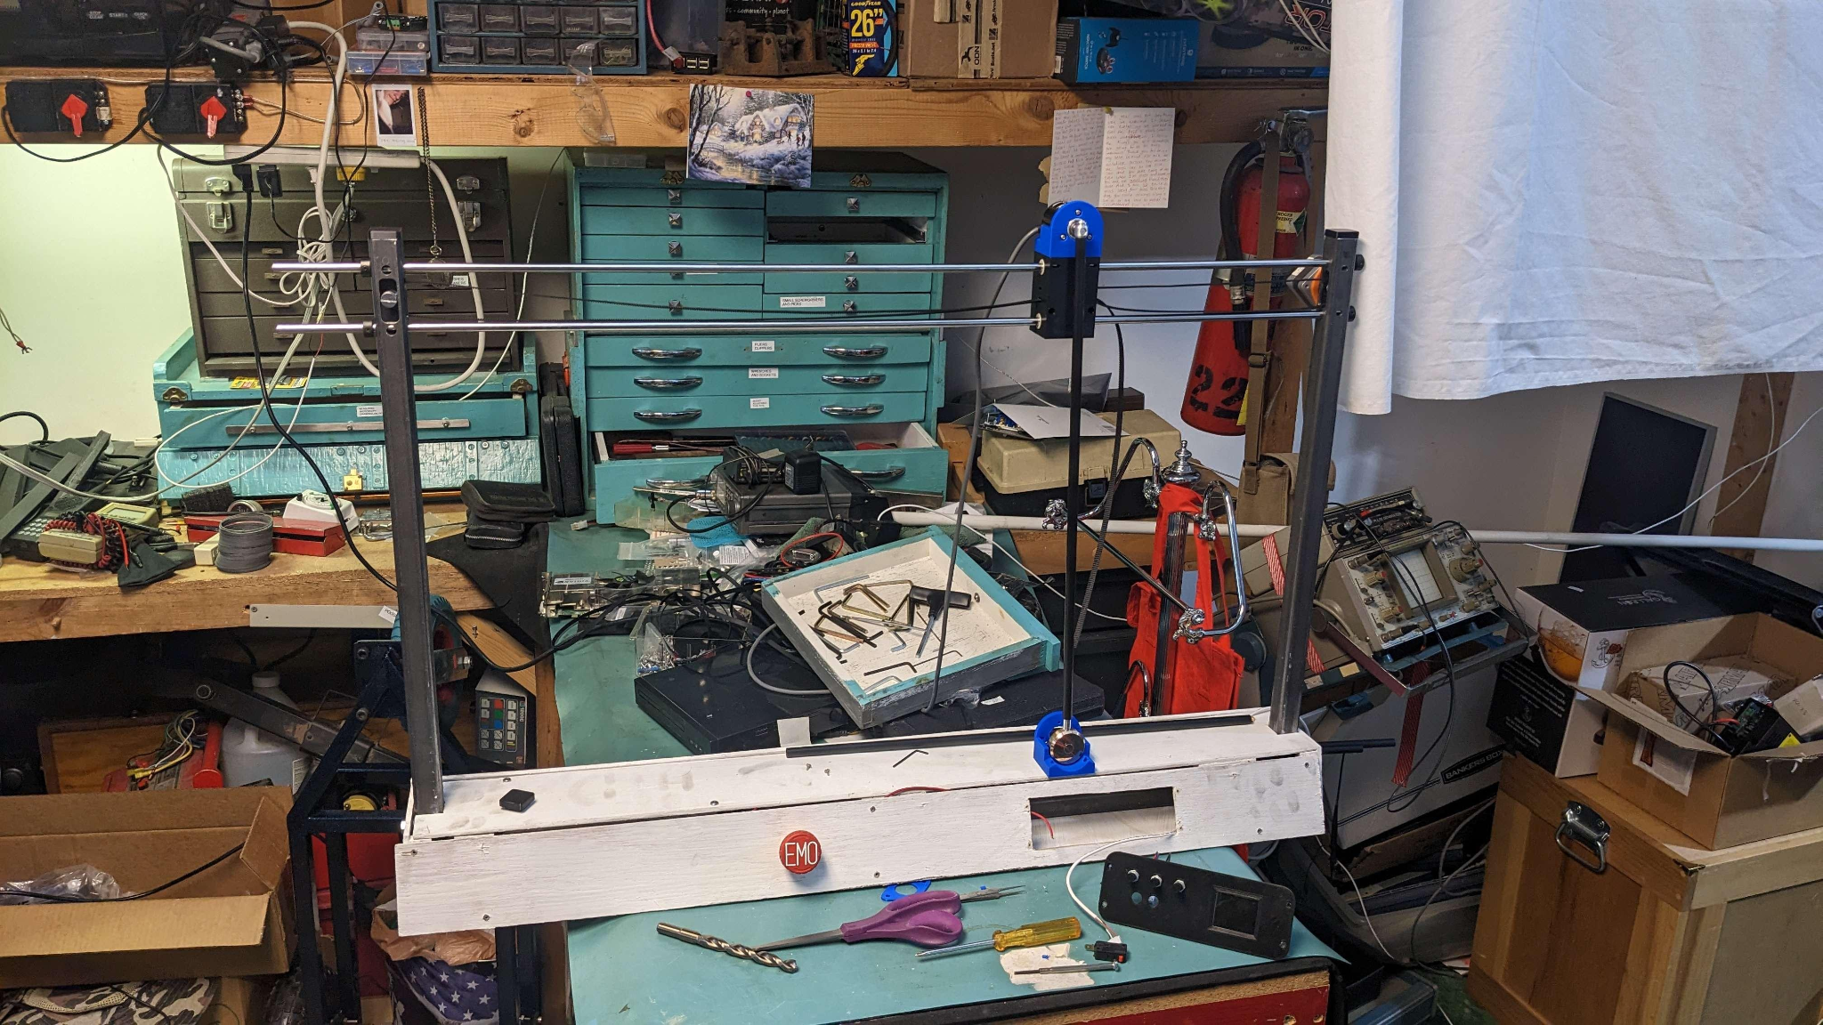
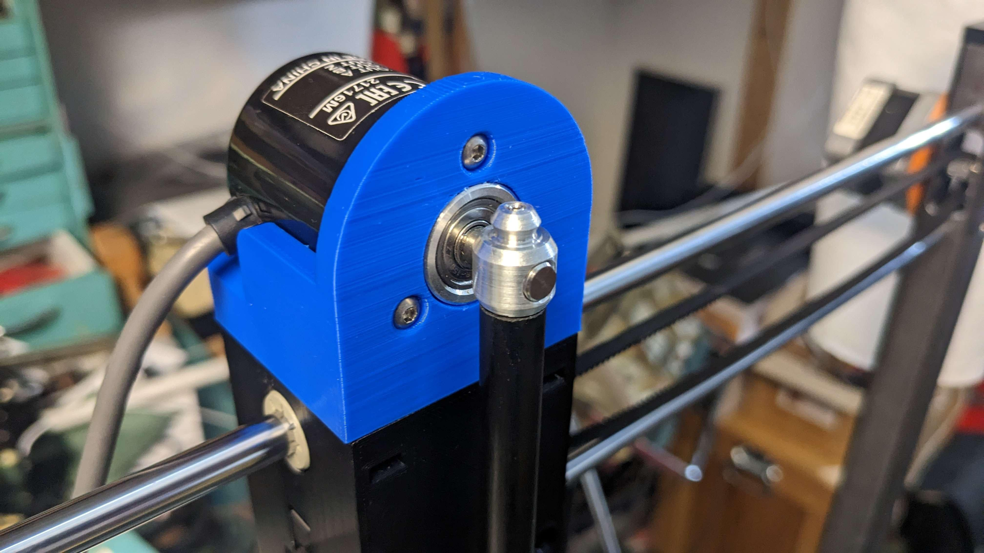
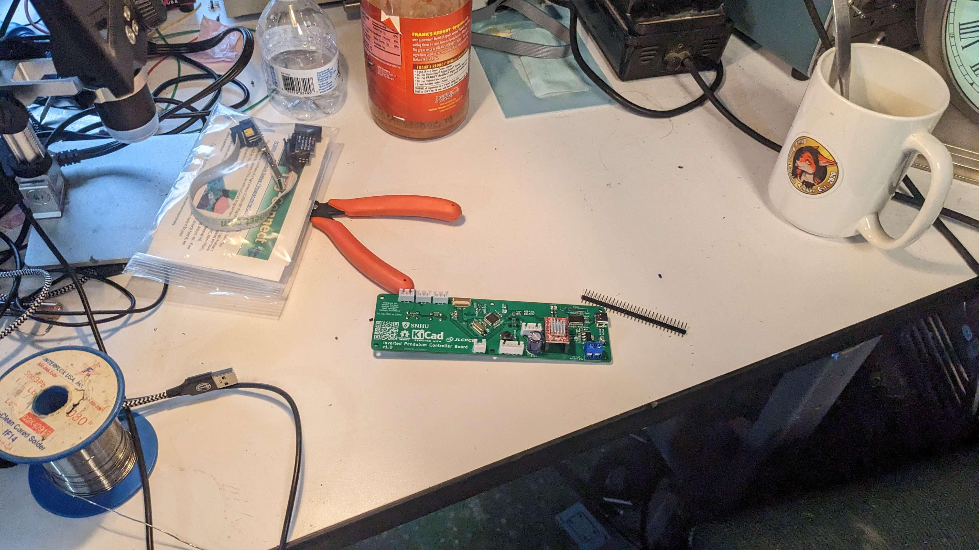
Current Build Status - Kat
All mechanical systems have been fabricated and are nominal. 100% done.
All electrical systems have been fabricated and are nominal except the built in debugger chip. A work-around was created. 95% done.
Software is still in development. 30% done.
3

Slide 4
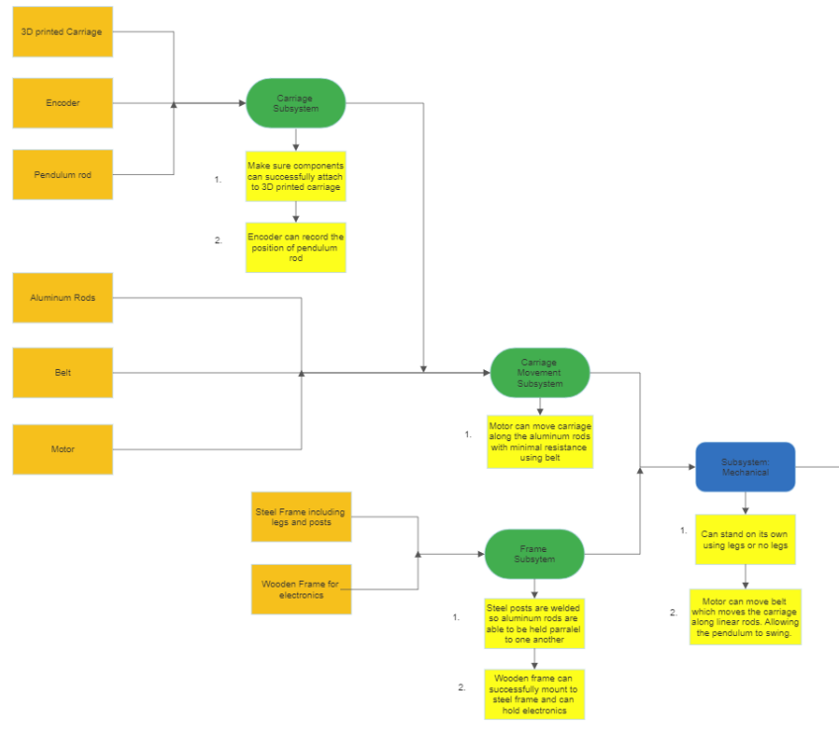
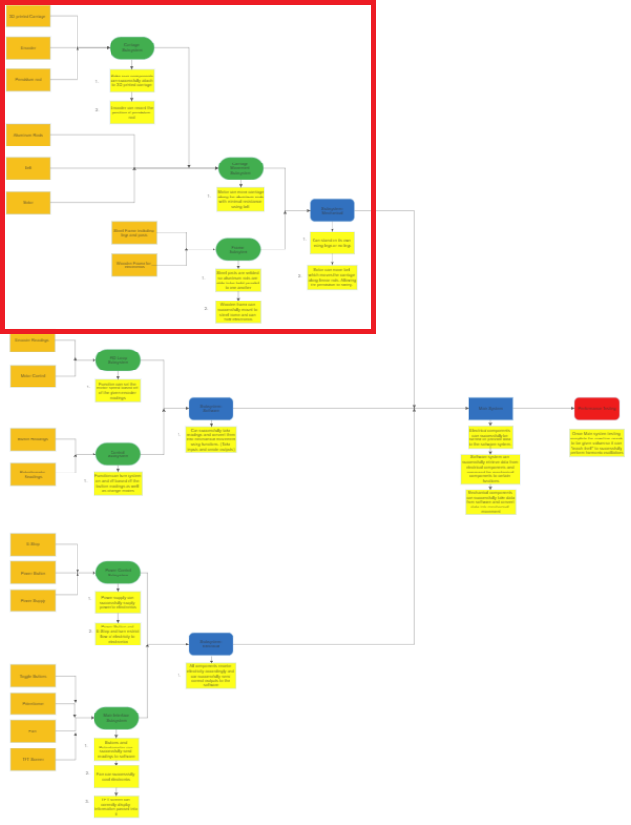
AI&T Flow - Austin
4

Slide 5
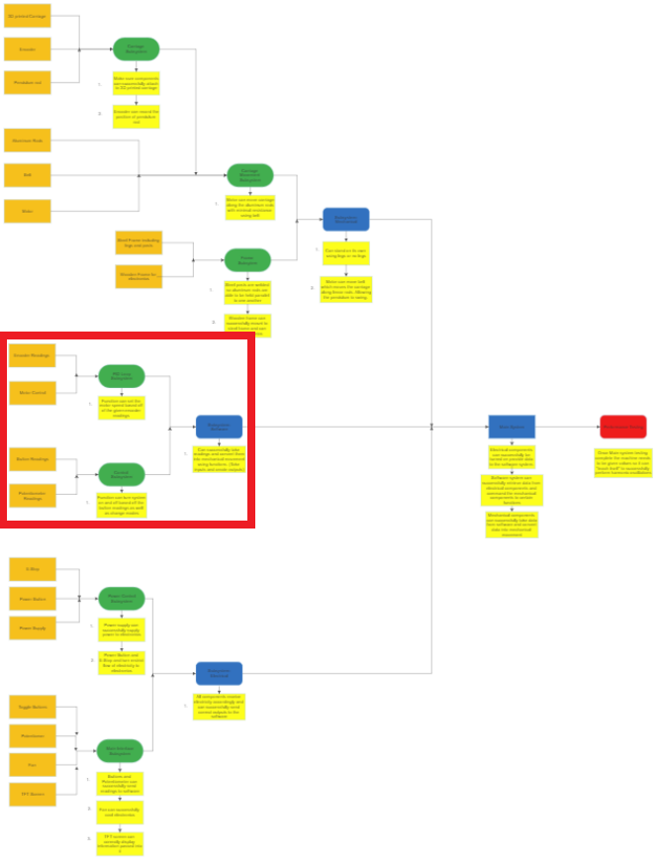
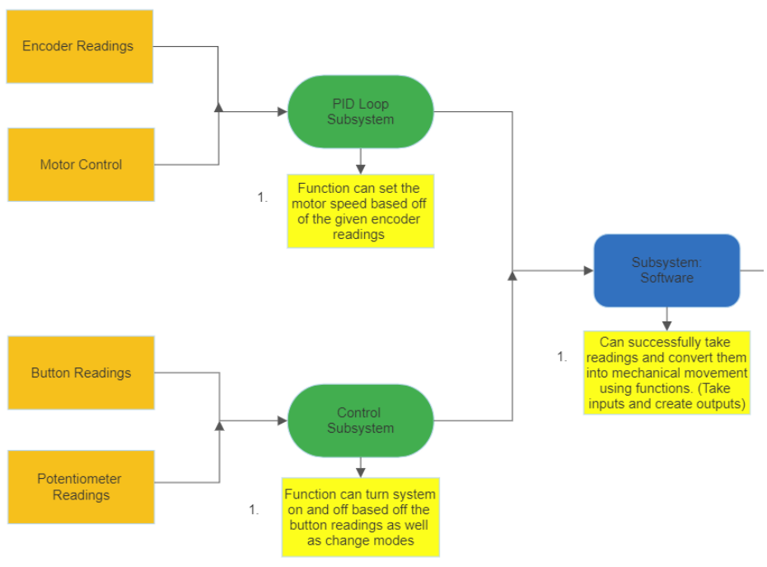
AI&T Flow (cont.)
5

Slide 6
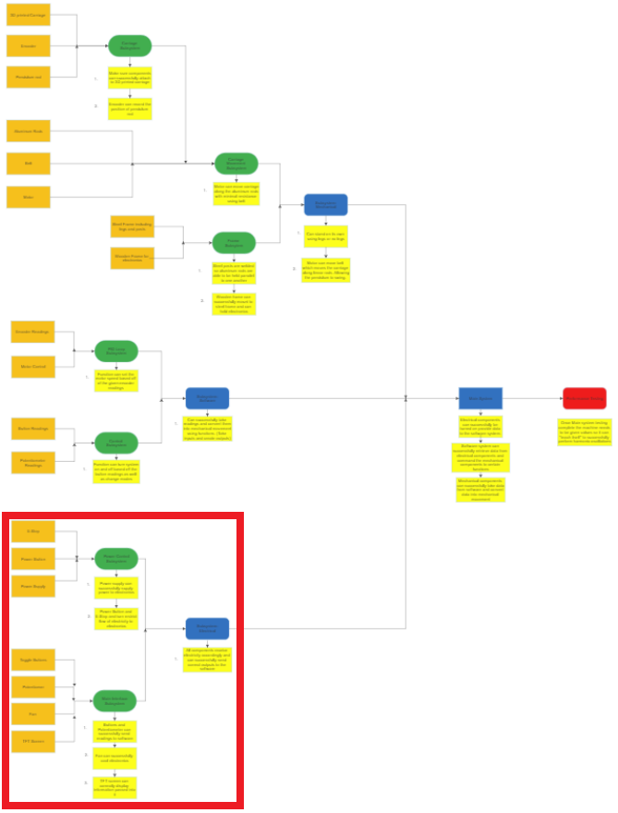
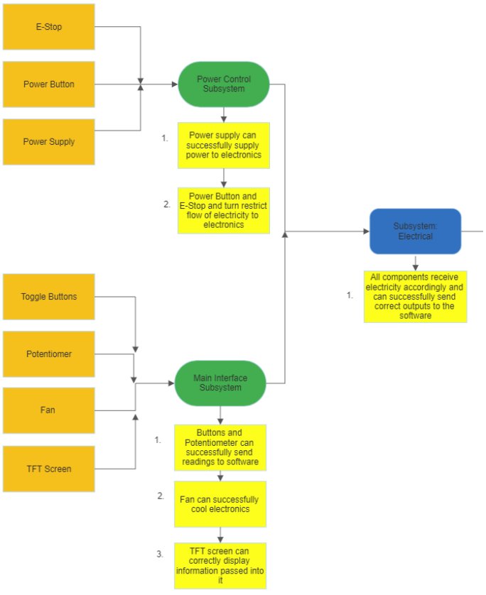
AI&T Flow (cont.)
6

Slide 7
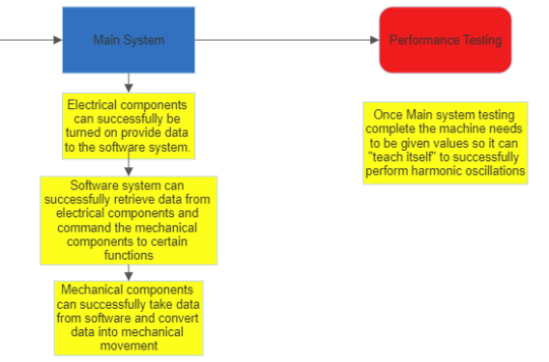
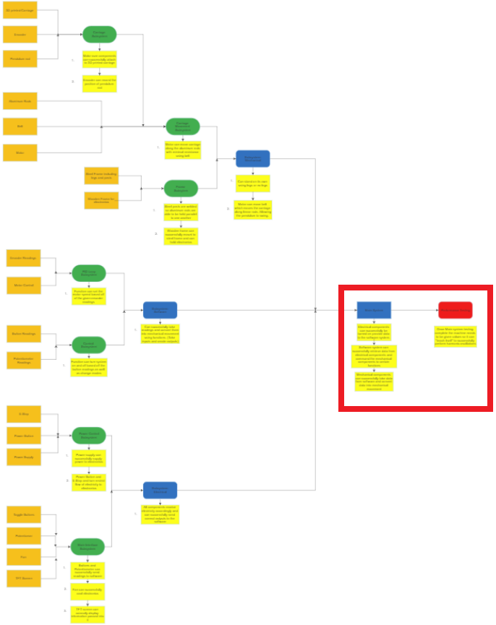
AI&T Flow (cont.)
7

Slide 8
AI&T Schedule - Kat
Harmonic oscillations
Planned for April 13th
TFT screen
Planned for April 13th
User interface mode
Planned for April 15th
Autonomous Mode
Planned for April 15th
Mode Toggling
Planned for April 15th
8

Slide 9
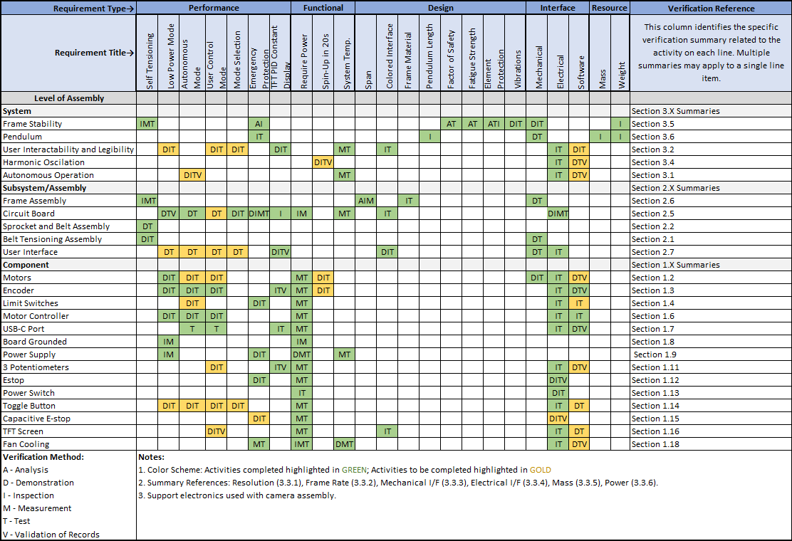
Verification Matrix - Matt
9

Slide 10
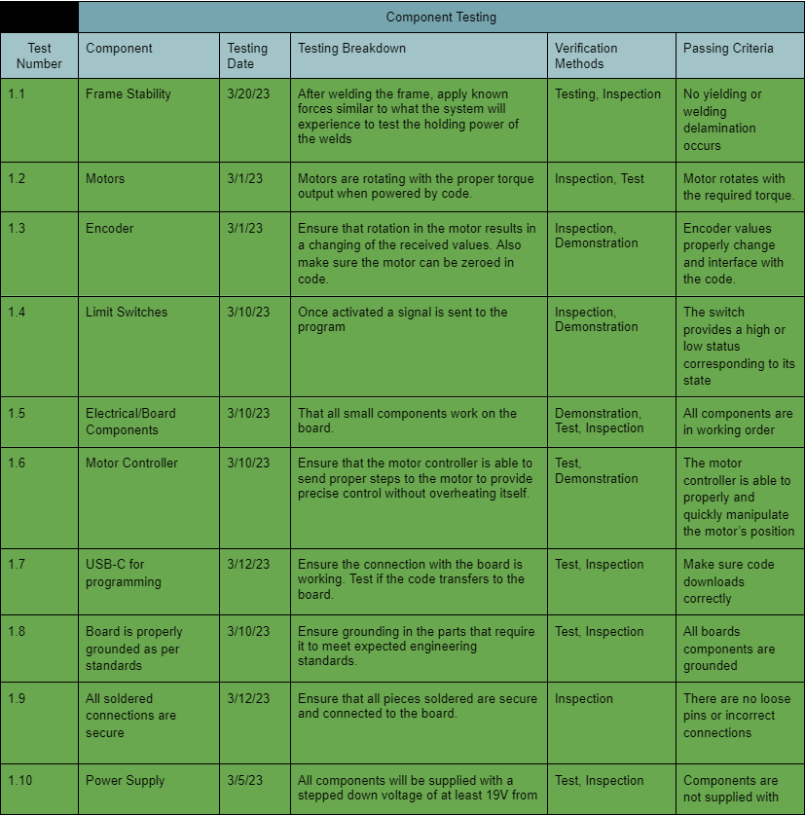
Component Level Verification
Green = Passed
Blue = Untested
Red = Failed
10

Slide 11
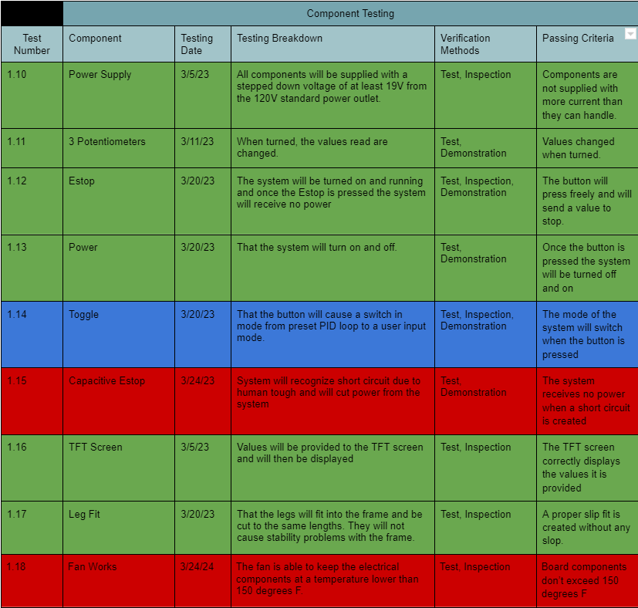
Component Level Verification (cont.)
11

Slide 12
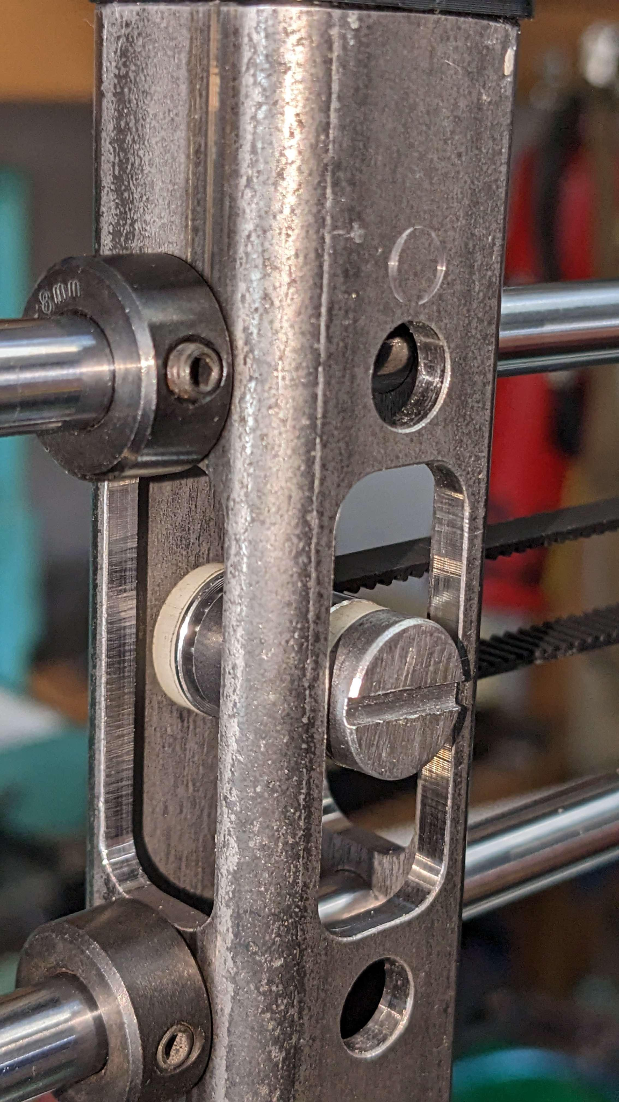
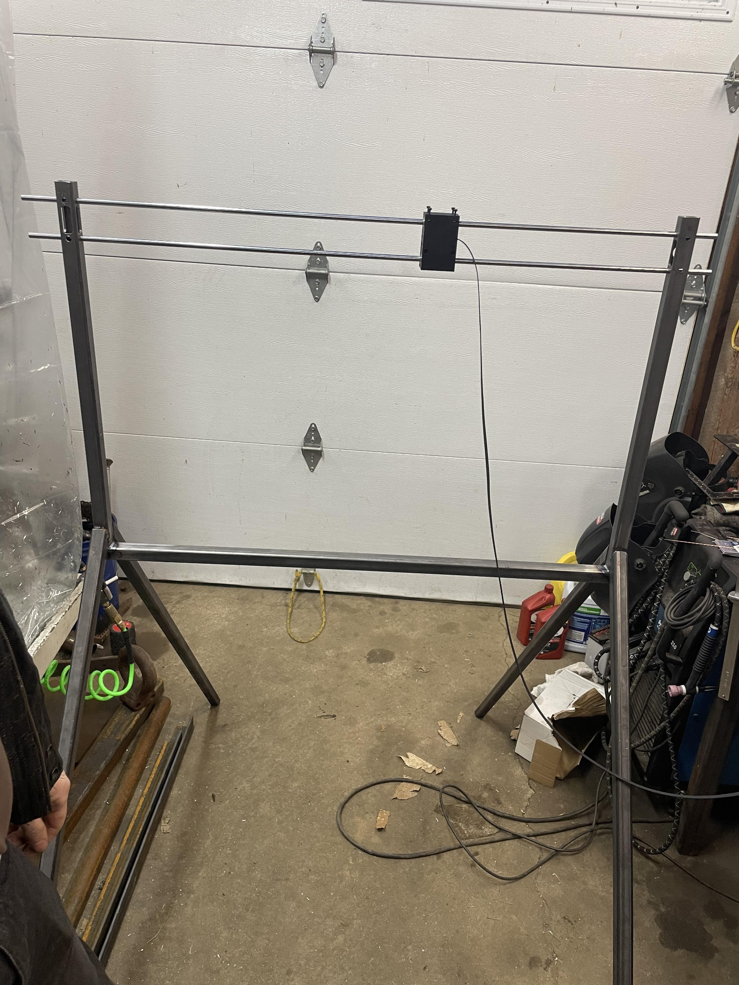
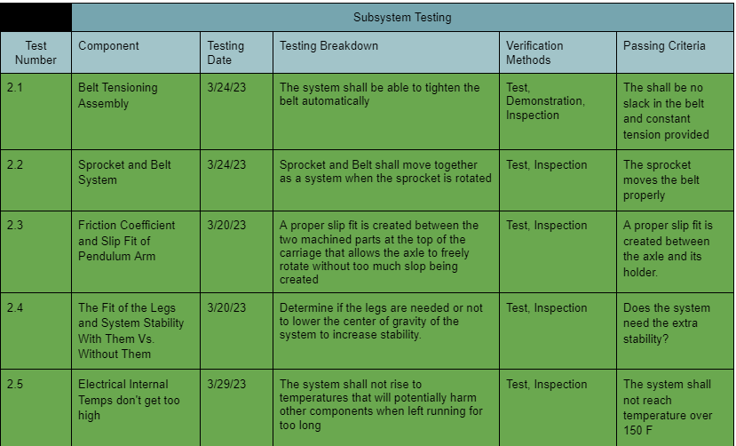
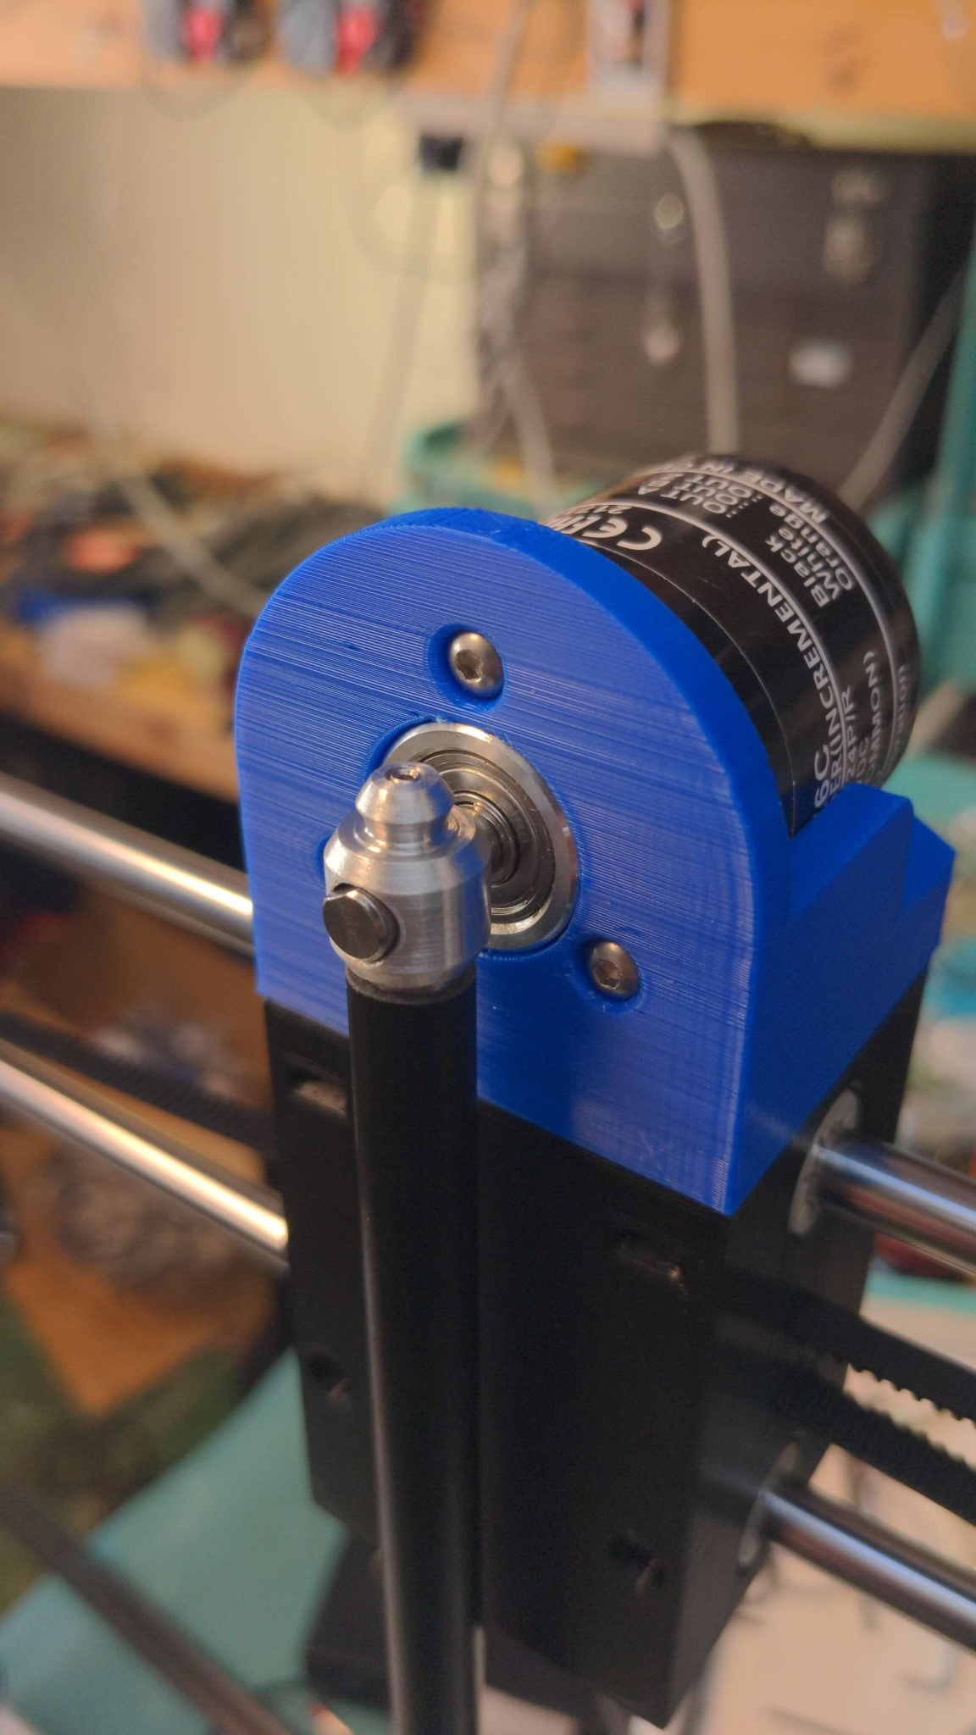
Subsystem Level Verification
12

Slide 13

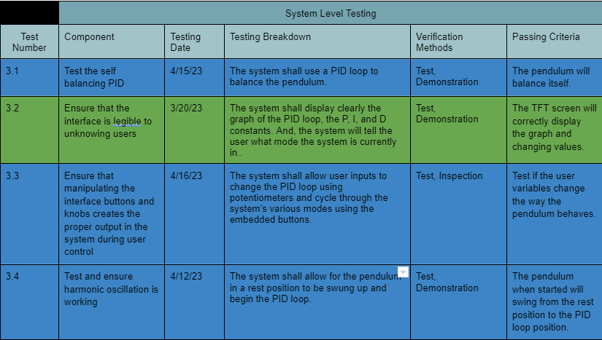
System Level Verification - Joe
Green = Passed
Blue = Untested
Red = Failed
13

Slide 14
Comprehensive Performance Test (CPT) - Joe
1.0 Frame Stability
The frame can hold >25lbs without deformation
1.9 All soldered connections are secure
When shaken all pin connections successfully stay in place
1.13 Power
The pendulum stops moving when the power button is pressed
1.16 TFT Screen
The screen displays the information that is provided
1.17 Leg Fit
Legs were placed into the frame without slip
2.1 Belt Tensioning Assembly
The belt is completely parallel meaning there is no slack
14

Slide 15
Environmental Tests - Kat
All wood element has been primed for both paint and environmental protection.
Dust and dirt protection has been implemented.
Cannot test the higher operating temperature range of the system due to the cool weather outside.
Component level specs should be able to survive all operating temperatures.
15

Slide 16
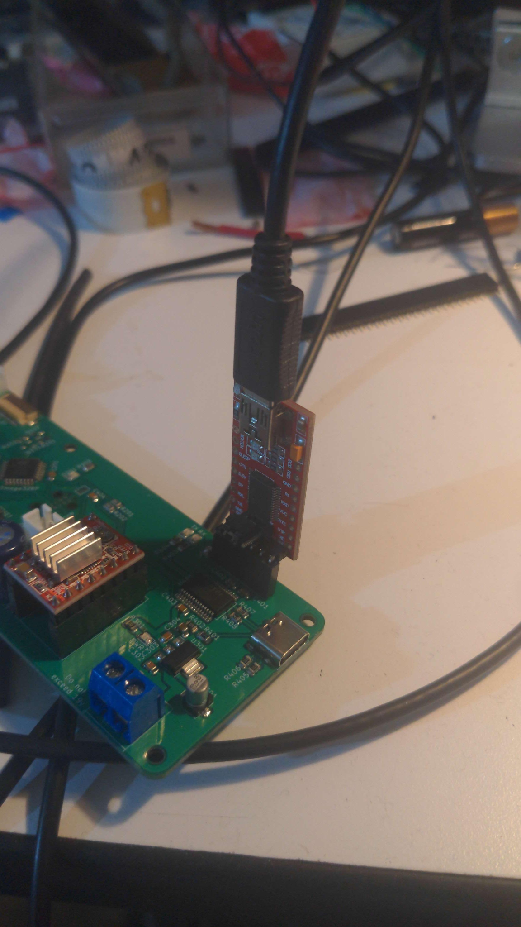
Problems and Potential Issues (Joe)
Debugging chip (circled in red) isn’t working.
Had to remove capacitive estop and pinch point protection due to time constraints.
Low power mode will be saved for last depending on software development for more critical features.
Need motor with more torque as it provide for less slipping with its internals
16

Slide 17

Questions?!

Slide 18
Backup Slides

Slide 19
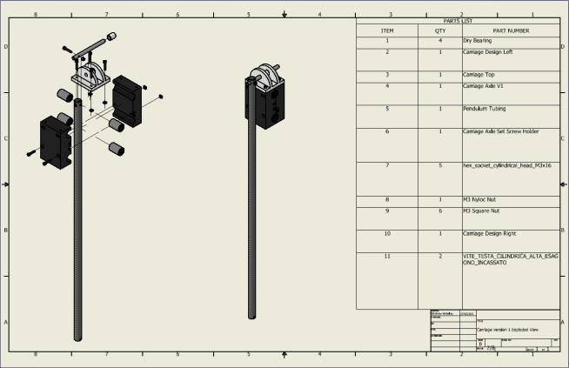

Slide 20
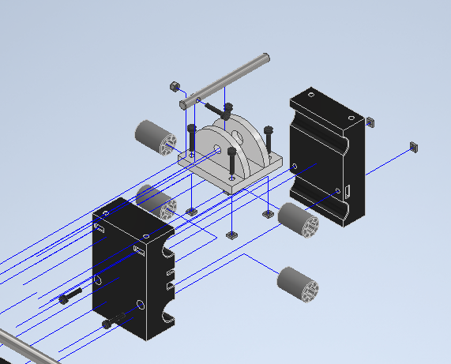

Slide 21
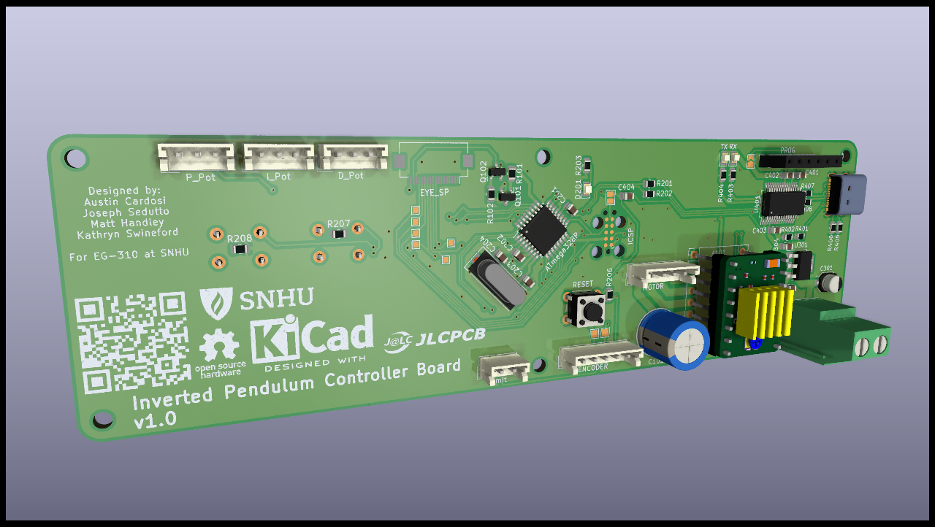

Slide 22
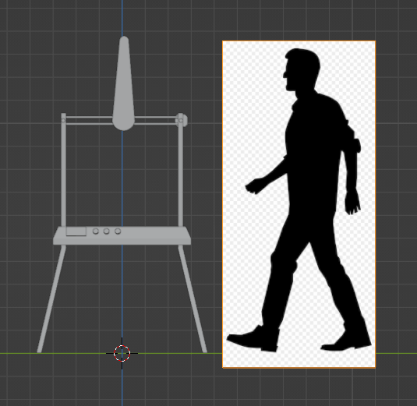
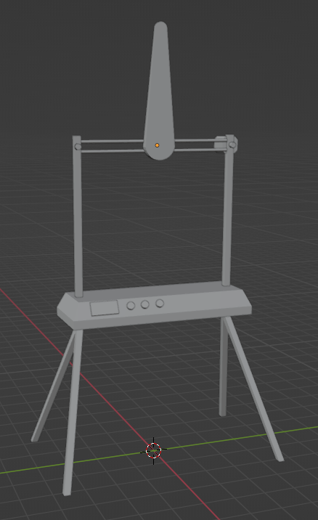

Slide 23
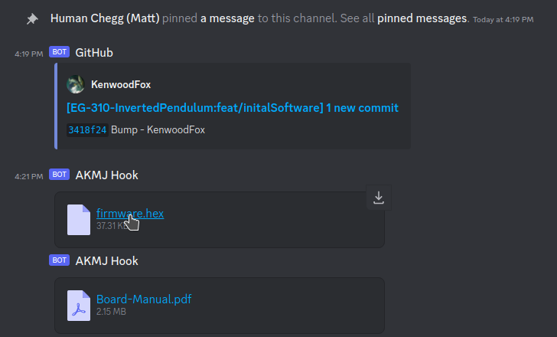

Slide 24
